Slide 1

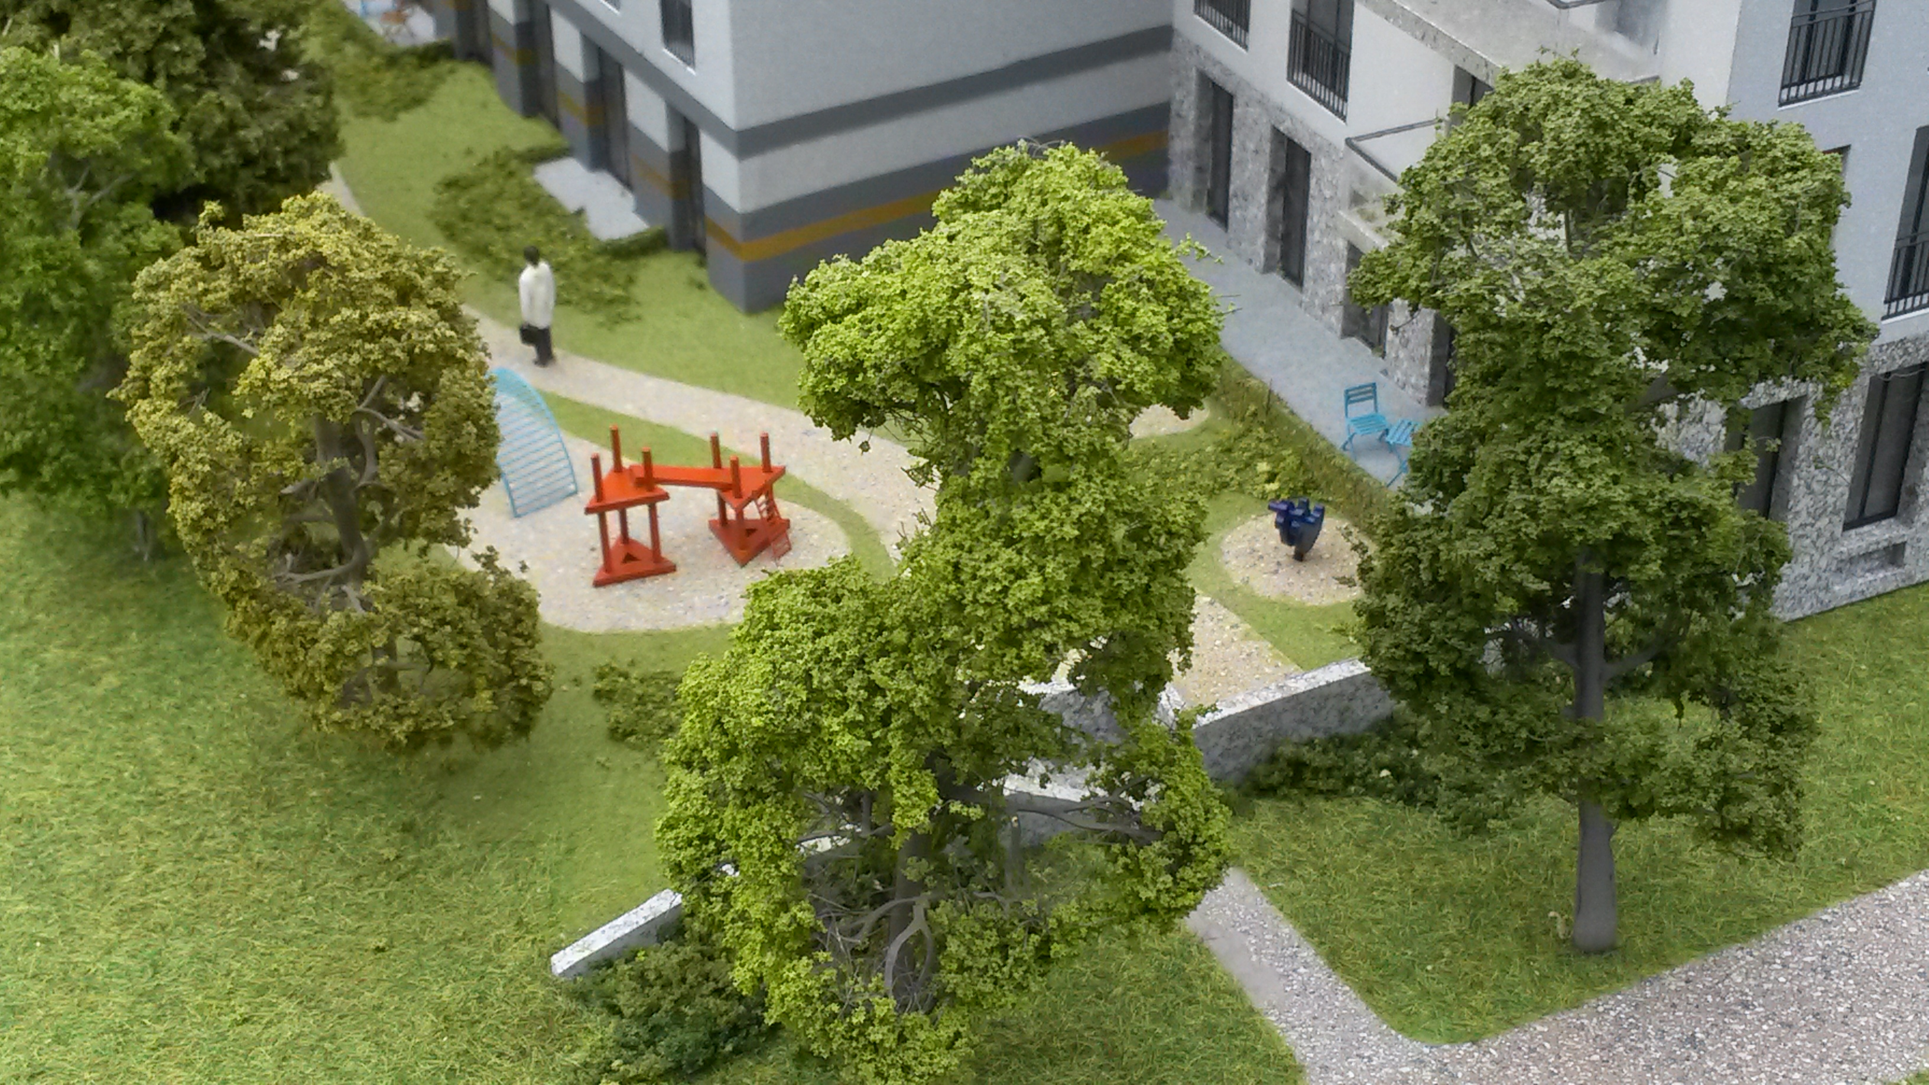
CROWLEYMODELMAKERS.COM building your ideas…
HOME
ABOUT US
PROJECTS
HOW
CONTACT
Copyright Crowley Modelmakers 2016

Slide 2
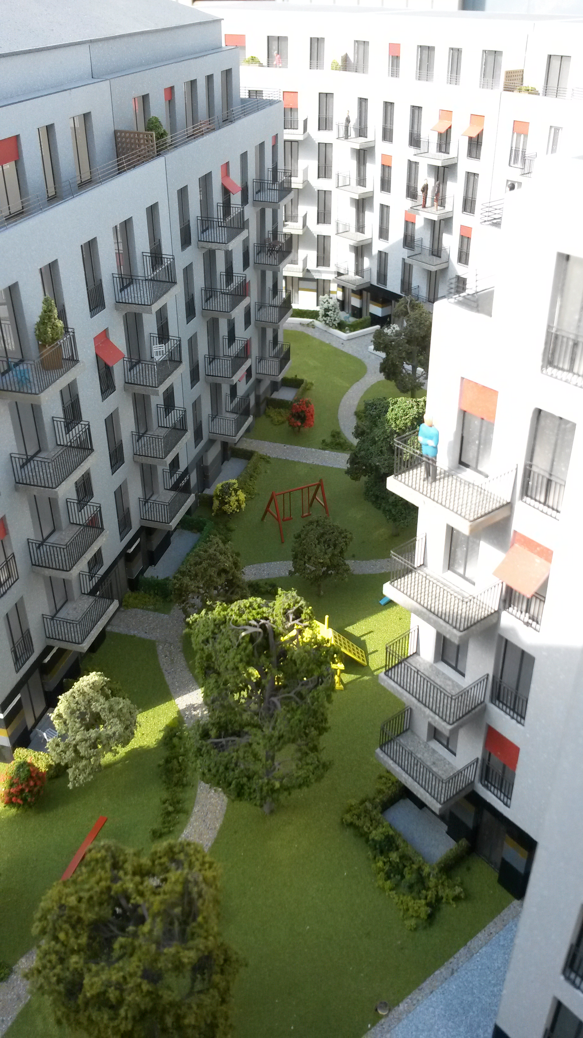

CROWLEYMODELMAKERS.COM building your ideas…
HOME
ABOUT US
PROJECTS
HOW
CONTACT
CROWLEY MODELMAKERS was established in 1976 and ever since, have been providing a quality of service that is second to none…
Copyright Crowley Modelmakers 2016

Slide 3

HOME
ABOUT US
PROJECTS
HOW
CONTACT
Copyright Crowley Modelmakers 2016

Slide 4
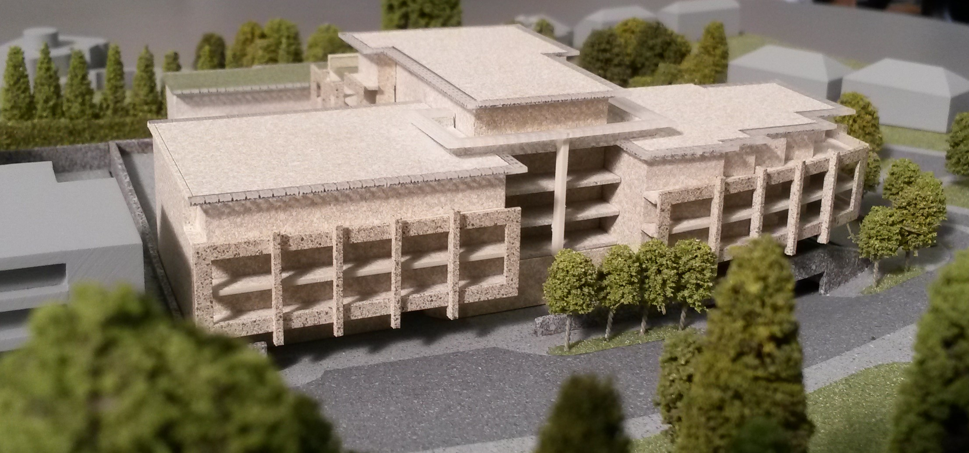
HOME
ABOUT US
PROJECTS
HOW
CONTACT
Copyright Crowley Modelmakers 2016

Slide 5
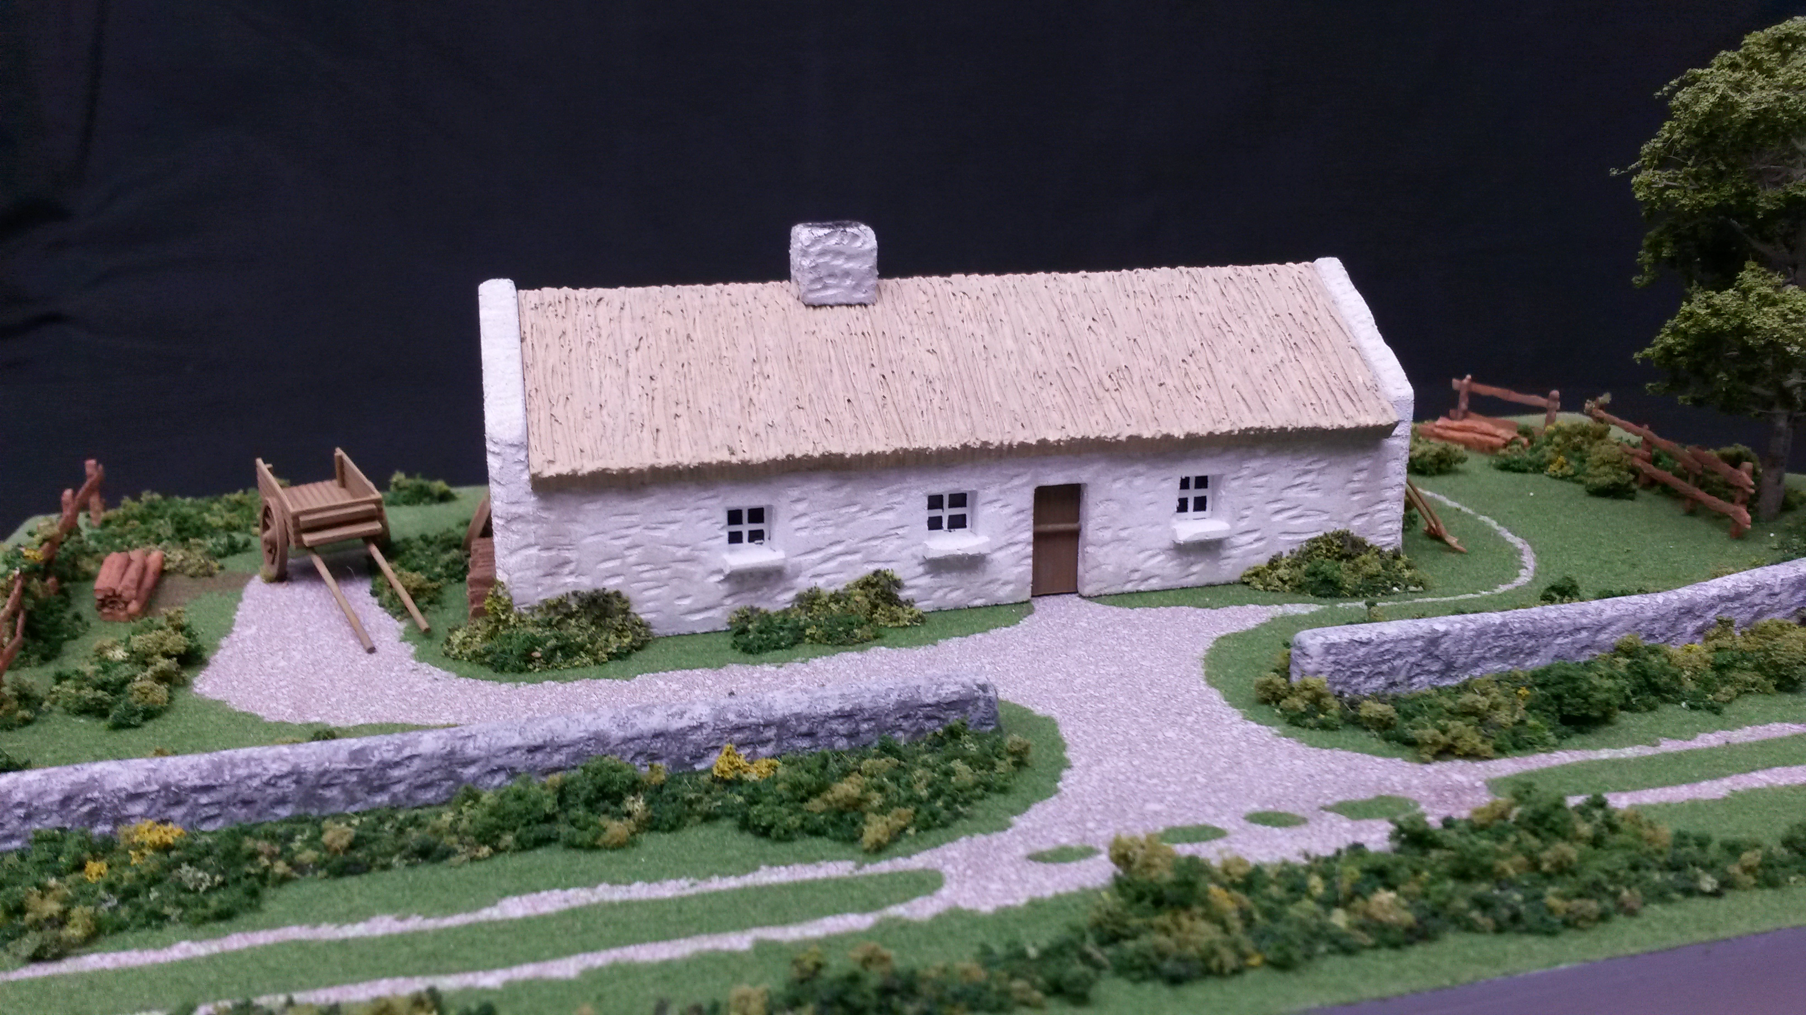
HOME
ABOUT US
PROJECTS
HOW
CONTACT
Copyright Crowley Modelmakers 2016

Slide 6
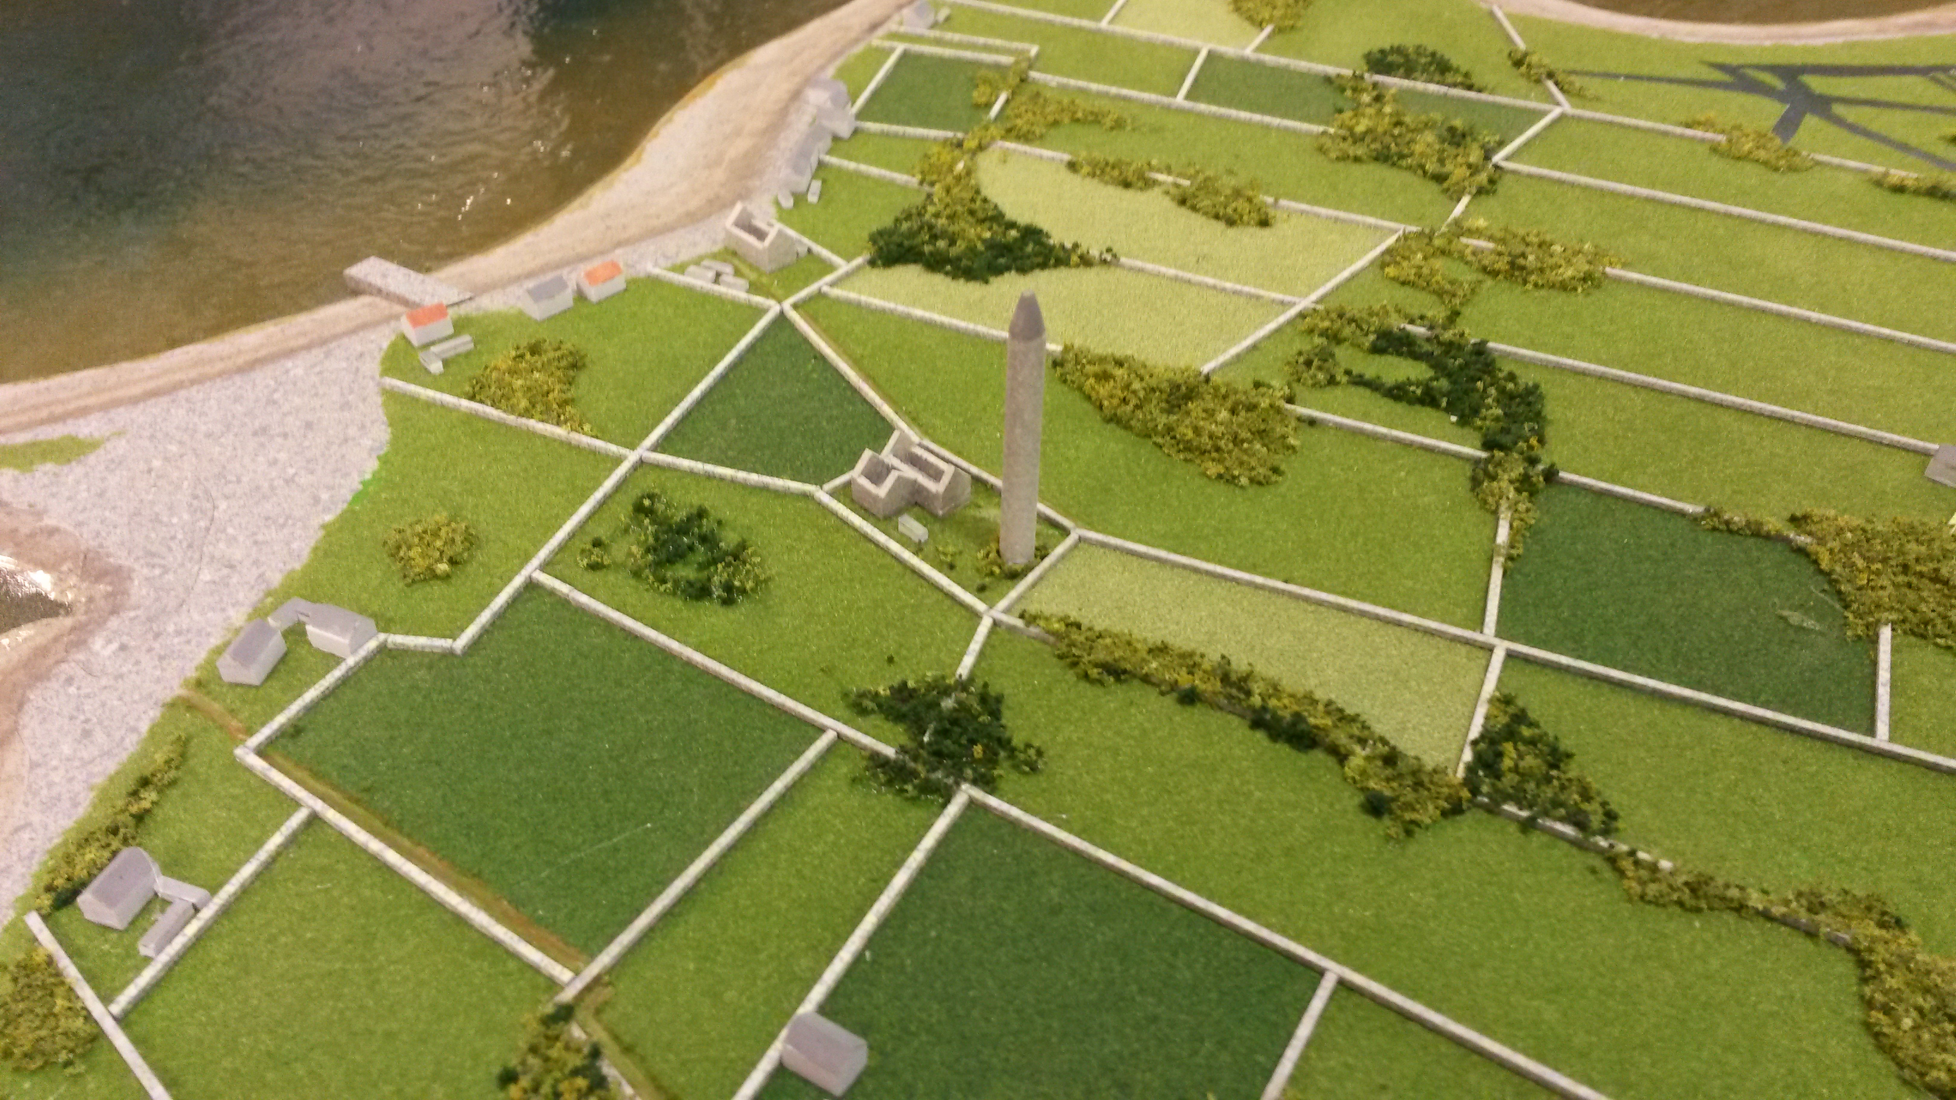
HOME
ABOUT US
PROJECTS
HOW
CONTACT
Copyright Crowley Modelmakers 2016

Slide 7
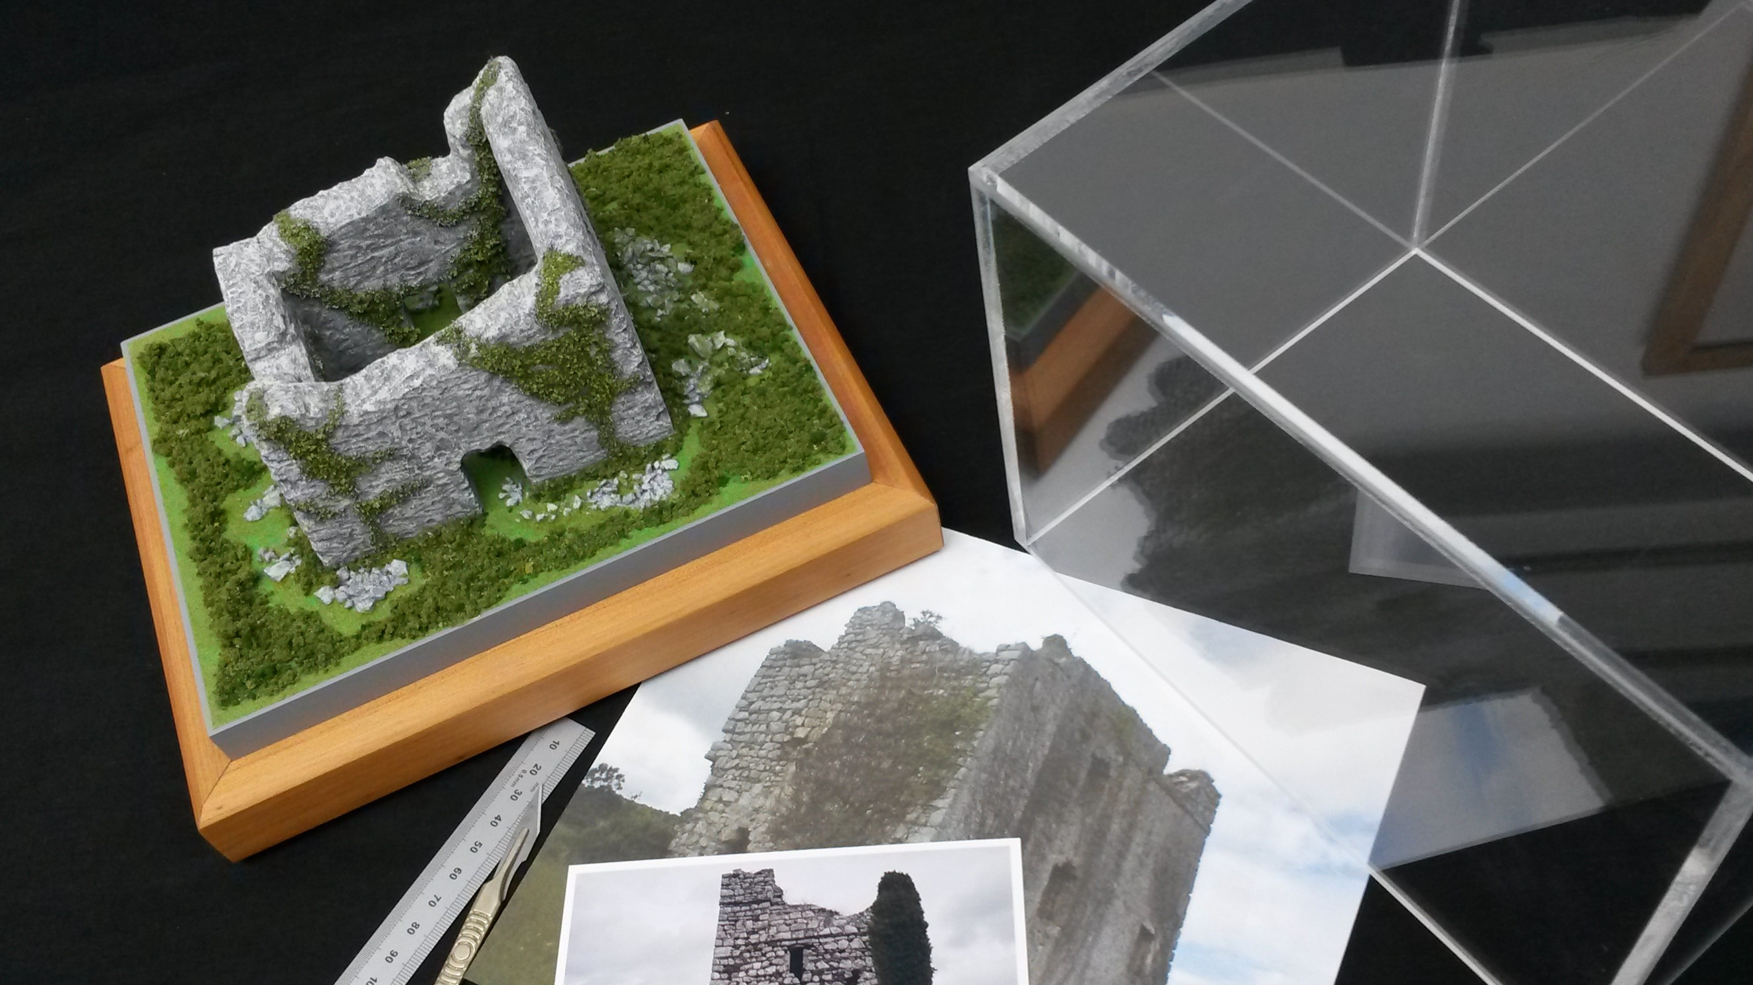
HOME
ABOUT US
PROJECTS
HOW
CONTACT
At Crowley Modelmakers, over 40 years experience along with the latest technologies in laser cutting, 3D milling and 3D printing, means we produce models for every type of scheme and budget with one absolute goal, to get you the maximum results.
Whether it’s helping planners to understand your vision, drawing crowds to your exhibition or driving sales in your marketing suite, let us give your idea the advantage it deserves.
Copyright Crowley Modelmakers 2016

Slide 8
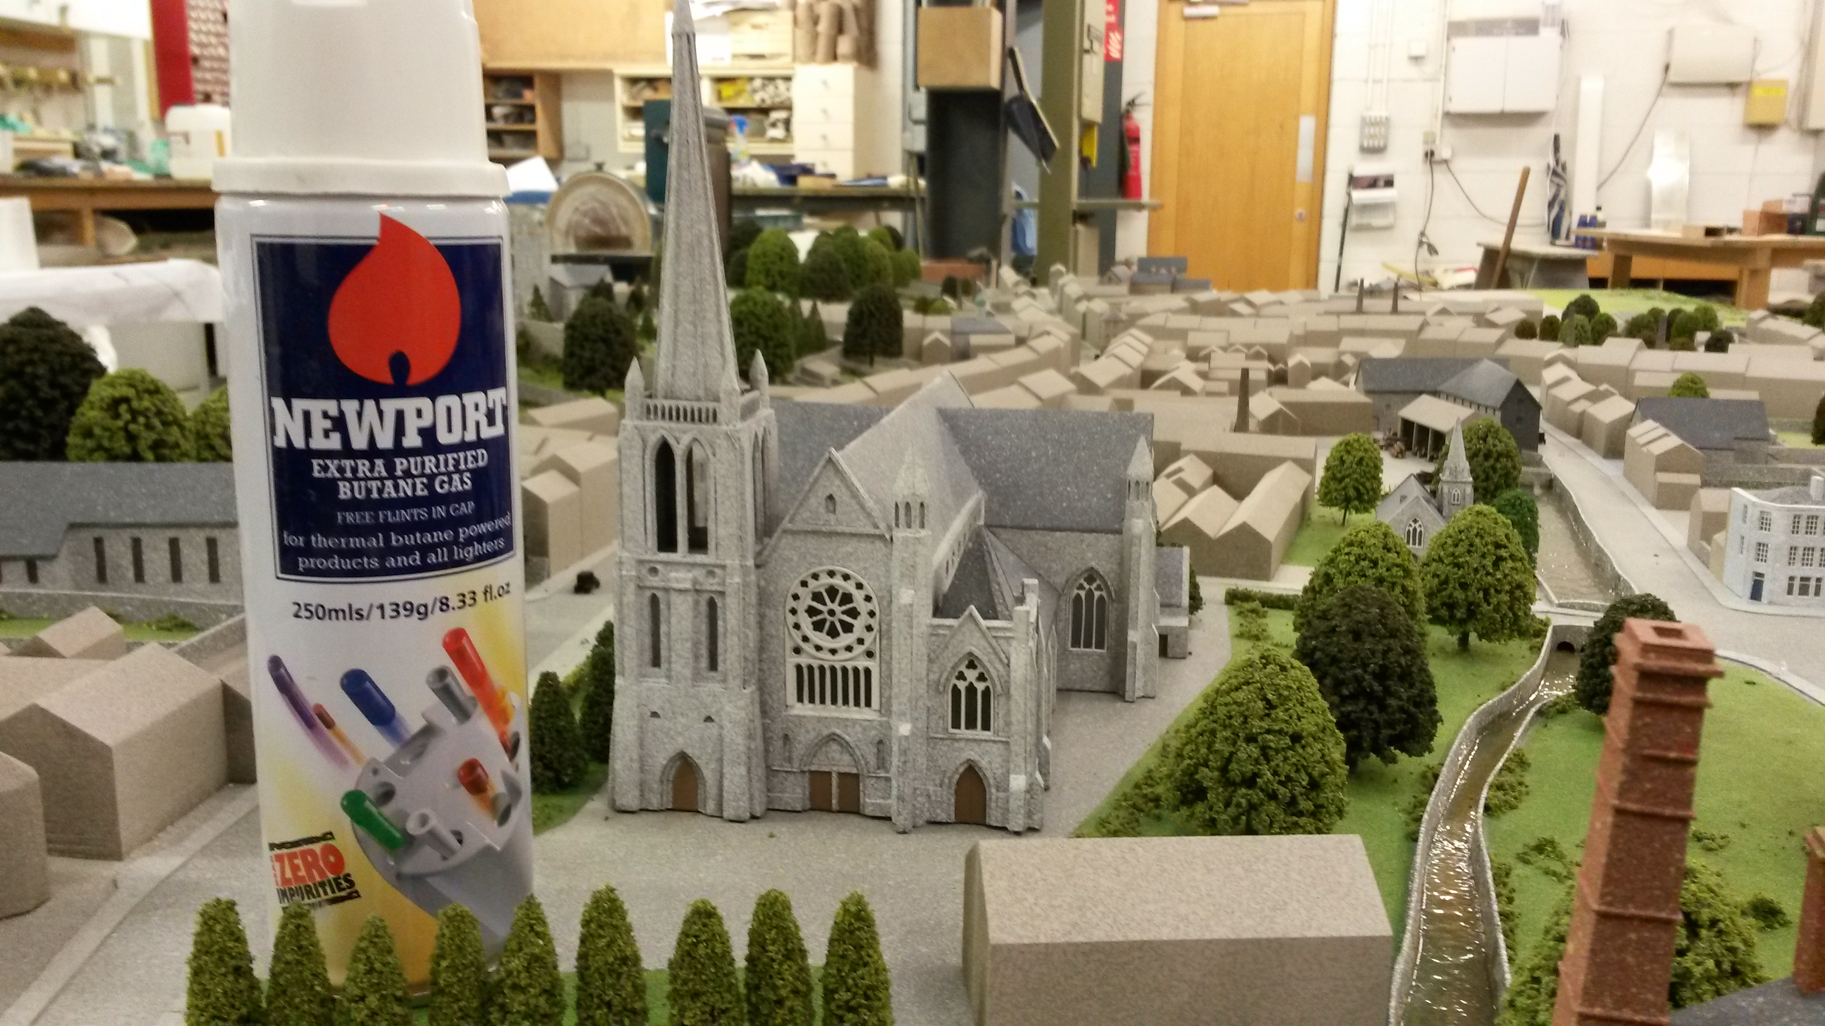
HOME
ABOUT US
PROJECTS
HOW
CONTACT
At Crowley Modelmakers, over 40 years experience along with the latest technologies in laser cutting, 3D milling and 3D printing, means we produce models for every type of scheme and budget with one absolute goal, to get you the maximum results.
Whether it’s helping planners to understand your vision, drawing crowds to your exhibition or driving sales in your marketing suite, let us give your idea the advantage it deserves.
Copyright Crowley Modelmakers 2016

Slide 9
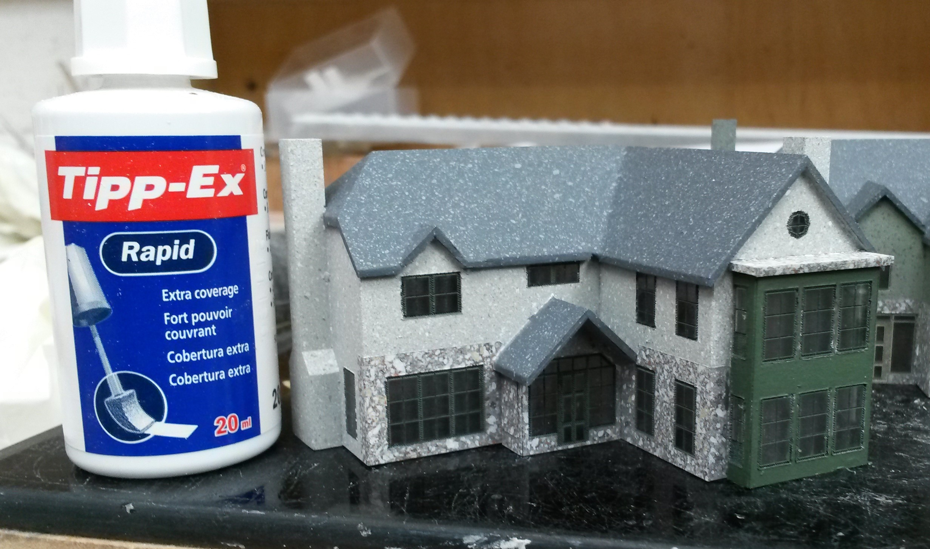
HOME
ABOUT US
PROJECTS
HOW
CONTACT
At Crowley Modelmakers, over 40 years experience along with the latest technologies in laser cutting, 3D milling and 3D printing, means we produce models for every type of scheme and budget with one absolute goal, to get you the maximum results.
Whether it’s helping planners to understand your vision, drawing crowds to your exhibition or driving sales in your marketing suite, let us give your idea the advantage it deserves.
Copyright Crowley Modelmakers 2016

Slide 10
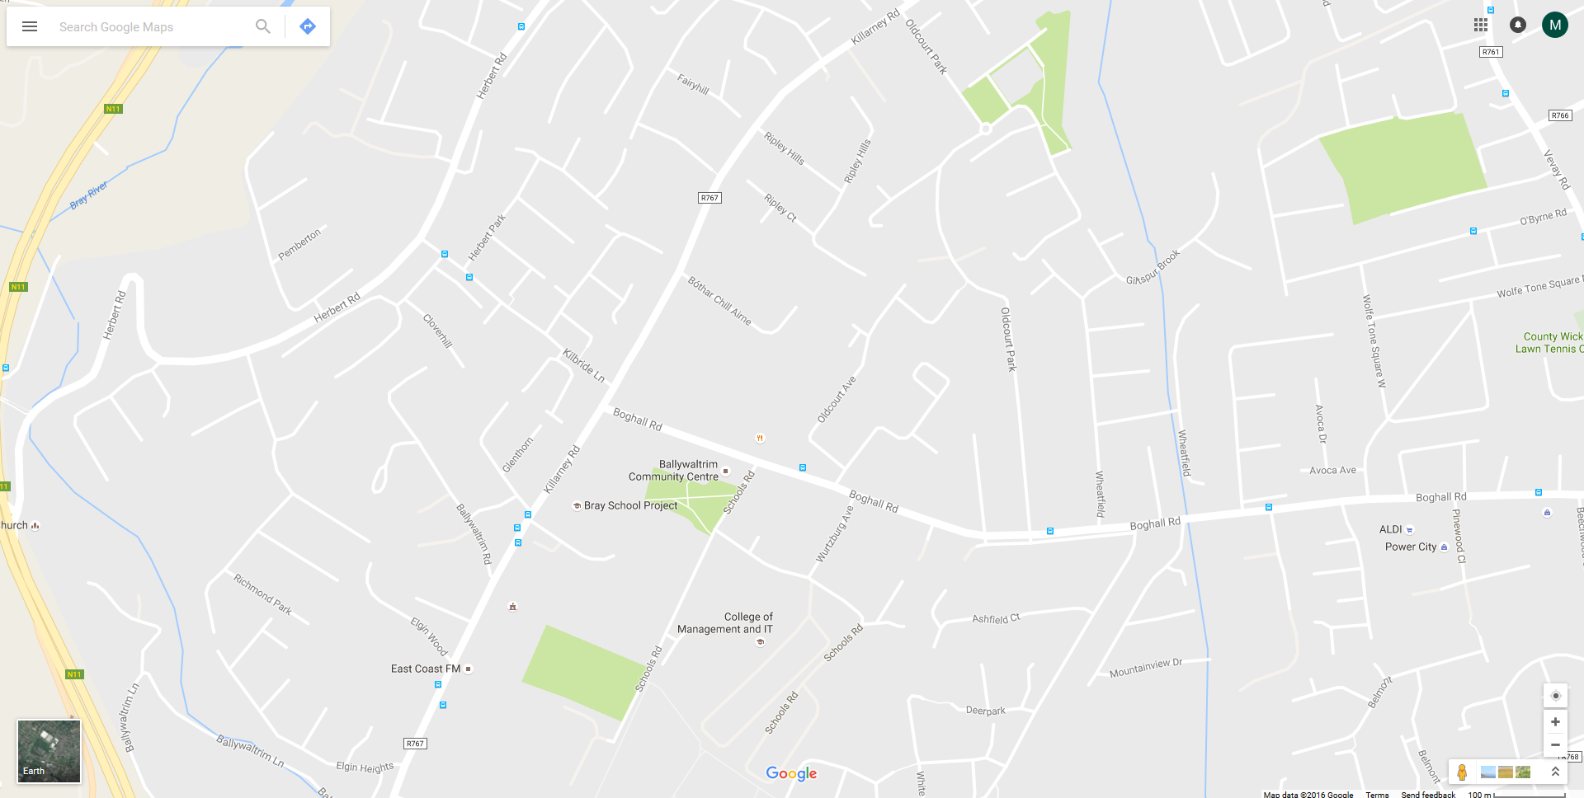

HOME
ABOUT US
PROJECTS
HOW
CONTACT
Unit B
Killarney Road Business Park
Bray
Co Wicklow
Ireland
GPS 53.190710, -6.121164
info@crowleymodelmakers.com
Phone +353 (0) 1 286 7657
Copyright Crowley Modelmakers 2016

